Slide 1

Chapter 10
Religion, Spirituality, and Well-Being

Slide 2
A Sense of Meaning and Purpose
Definitions
Spirituality
Personal or group search for sacred in life
Religion
Search for sacred within traditional context (e.g., formal religious institution)
Both refer to a need to relate to something greater than oneself and often require transcendence

Slide 3

A Sense of Meaning and Purpose
Horizontal transcendence: forming a relationship with a force that is more immanent in the world, less often a spiritual being
e.g., Tao: the absolute principle underlying the universe, combining within itself the principles of yin and yang and signifying the way, or code of behavior, that is in harmony with the natural order
Vertical transcendence: fostering relationship with higher being
e.g., Judeo-Christian God

Slide 4
A Sense of Meaning and Purpose
Religion and Subjective Well-Being
Greater religiousness—better mental health, higher subjective well-being
Better emotional well-being
Lower rates of delinquency, alcoholism, drug abuse, and other social problems
Greater happiness, life satisfaction
Decrease death anxiety

Slide 5
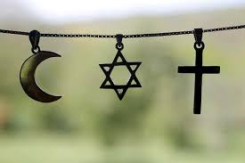
A Sense of Meaning and Purpose
Religion and Subjective Well-Being
Greater religiousness—better mental health, higher subjective well-being
Mediators
Women, African American, and older show stronger relationship between religiousness and well-being
Public religious participation or active involvement in religious activities are key
May be that allegiance to a belief system is the core psychological process involved

Slide 6
A Sense of Meaning and Purpose
Religion and Health
Greater religiousness—fewer illness, lower rates for cancer and heart attacks, recover more quickly from illness/surgery, greater tolerance for pain
Why? Lower BP, better immune functioning, reduced stress and worry; “learned hardiness”
Most important predictor of improved health status: ability of religion to provide a sense of meaning and purpose or sense of coherence
Results stronger for women and for active participation

Slide 7
A Sense of Meaning and Purpose
Why is Religion Related to Well-Being?
Provides social support
From religious group members, from God
Major religions share 5 ethical directives
“golden rule” do unto others
Better to give than receive
Express gratitude
Forgiveness encouraged
Discourage comparisons of self and others and encourage acceptance

Slide 8
A Sense of Meaning and Purpose
Why is Religion Related to Well-Being?
Supports healthy lifestyles
Prohibition of risky health behaviors
Promotes personality integration
Mental traits—intelligence, emotions, impulses, volitions, native and acquired reactions organized and integrated into a unity
Promotes positive emotions
Emotions: gratitude, forgiveness, awe, love, compassion, humility, sense of peace

Slide 9
A Sense of Meaning and Purpose
Why is Religion Related to Well-Being?
Provides unique coping strategies
Provides hope
Offers reasons for stressors
Prayer
Provides sense of meaning and purpose
Ultimate meaning (addressed in next section)

Slide 10
A Sense of Meaning and Purpose
Meaning and Subjective Well-Being
Sense of meaning in life predicts well-being (positive emotion, joy love, vitality), leads to healthier behaviors, acts as a buffer against negative effects of stress
Meaning in life is major criterion for eudaimonia
Presence of meaning related to increase well-being, but search for meaning decreases happiness
"Search" for meaning indicates that it's missing

Slide 11
A Sense of Meaning and Purpose
Types of Meaning
Religion offers larger perspective on human life and gives explanations for unexpected events, offers hope
Personal/situational meaning derived from elements of personal life
Cosmic meaning or global meaning, extent to which human life fits into some overall coherent pattern
Meaning is a process rather than a product

Slide 12
A Sense of Meaning and Purpose
Ways to Create Meaning: Greater Harmony, Coherence, and Congruence
Greater meaning created when there is increased harmony, coherence, and congruence among the various aspects of our identity and life goals
Religious attitude can pull elements of life into a consistent direction
Creating meaning is a process of reducing discrepancy between our current situation and global meaning
Process accomplished by renewing sense of control, predictability, and order, or restoring belief that benevolence, justice, and fairness exist in some way in both humanity and cosmos

Slide 13
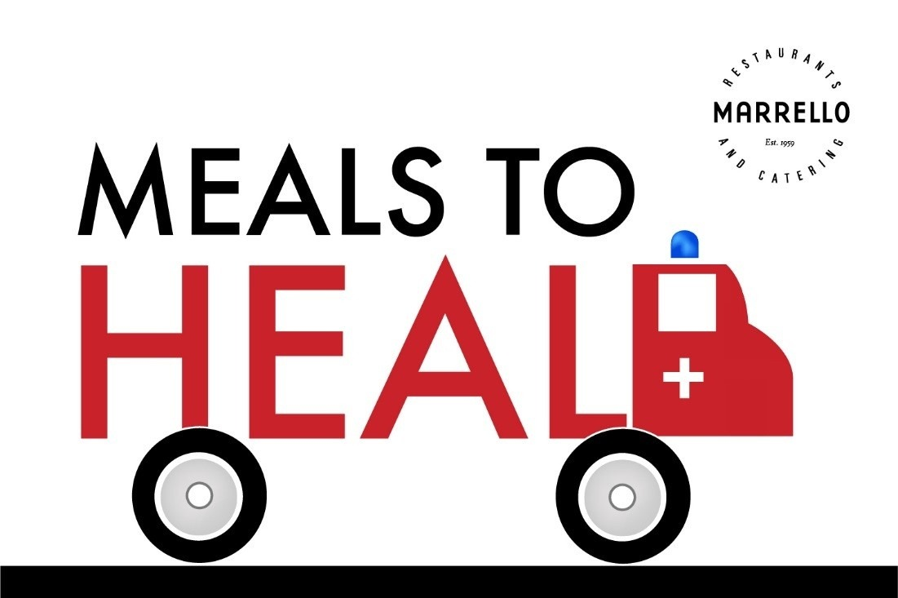
A Sense of Meaning and Purpose
Ways to Create Meaning: Be of Service to Others or Dedicate Oneself to a Worthy Cause
By helping others we make a difference in the world
Dedicating to cause larger than us can create a sense of meaning

Slide 14


A Sense of Meaning and Purpose
Ways to Create Meaning: Creativity
Creation of something new gives life significance
Scientific creativity also gives meaning and purpose
Creativity can lead to self-discovery, creating new self-identity

Slide 15
A Sense of Meaning and Purpose
Ways to Create Meaning: Live Life as Fully and Deeply as Possible
Desire to experience life fully can provide sense of active participation and involvement
Does not refer to obsessive effort to seek pleasure

Slide 16

A Sense of Meaning and Purpose
Ways to Create Meaning: Suffering
Our approach to suffering determines experience of meaning in life
Under difficulties, people reevaluate their lives and transform themselves
Religions dictate that suffering stimulates spiritual growth

Slide 17

A Sense of Meaning and Purpose
Ways to Create Meaning: Suffering: Potential Benefits
Increased self-confidence
Opportunities for enhanced interpersonal relationships
Avenues for changing one’s philosophy of life or style of creating meaning

Slide 18

A Sense of Meaning and Purpose
Ways to Create Meaning: Religious Experiences
Profound experiences increase sense of meaning in life

Slide 19
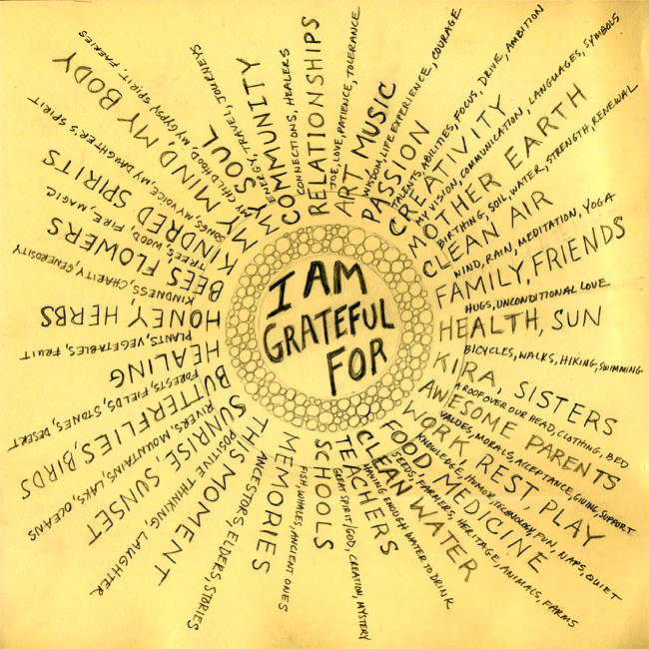
The Sacred Emotions
Gratitude and Appreciation
Gratitude is greatest of virtues and parent of others (Cicero)
Researchers are divided whether gratitude is emotion or attitude
Grateful people tend to be happy people
Gratitude can be nurtured through practice
Gratitude letter
Gratitude journal

Slide 20

The Sacred Emotions
Gratitude and Appreciation
Gratitude can maintain and enhance personal relationships
Gratitude related to greater life satisfaction, optimism, and more positive and less negative emotionality
Gratefulness related to wanting to give back to others…can expand outward and benefit the world

Slide 21
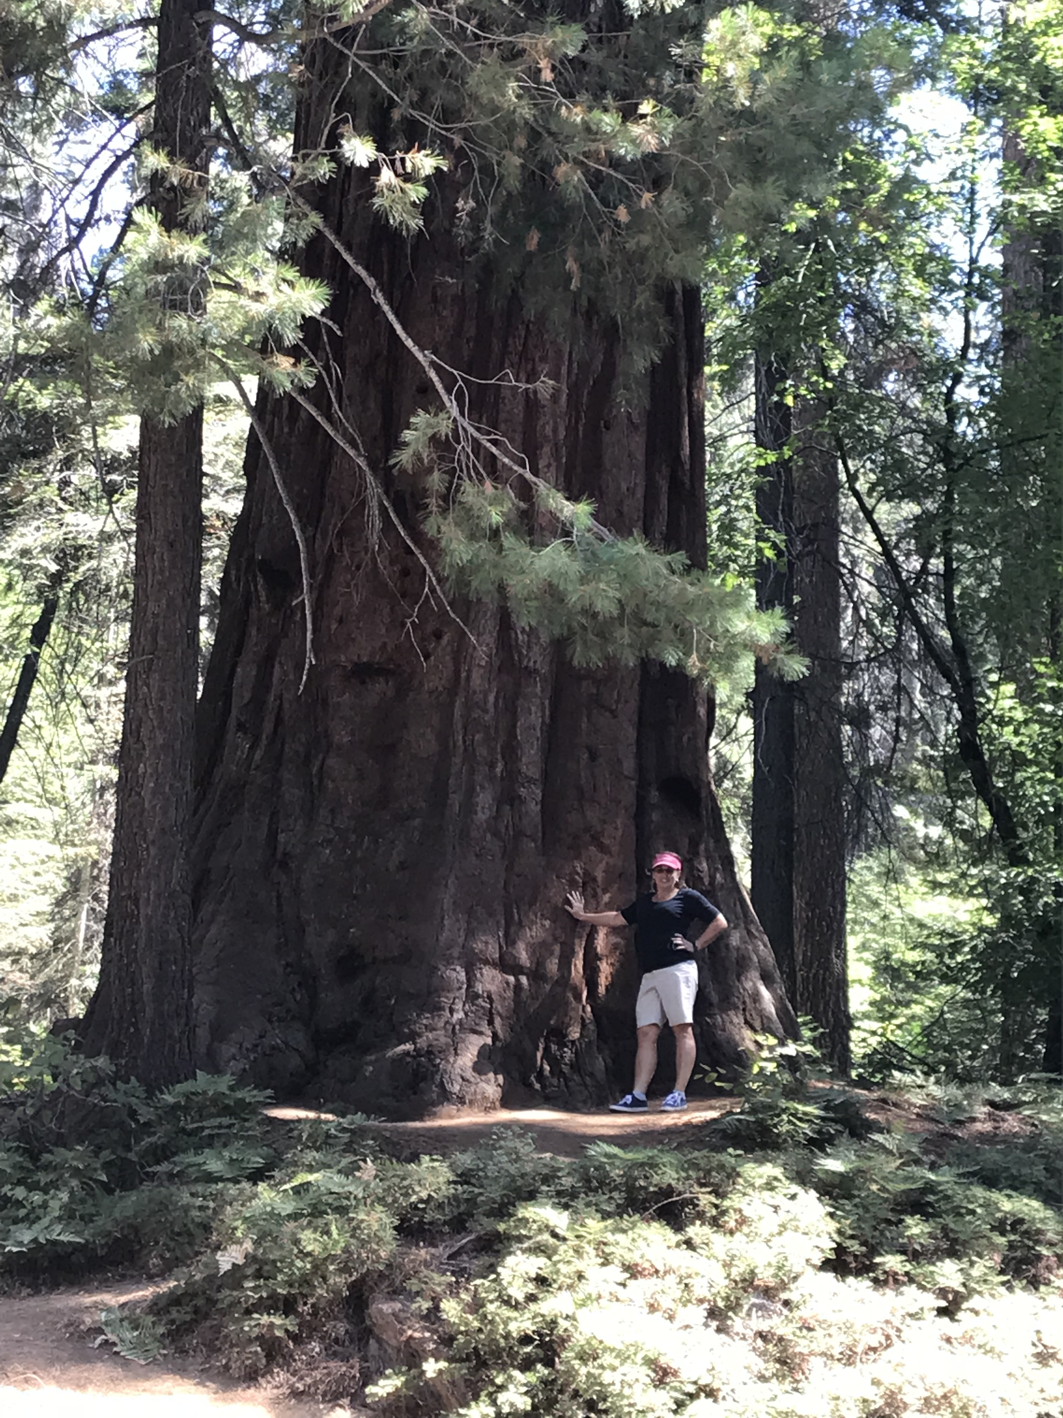
The Sacred Emotions
Gratitude and Appreciation
Appreciation helps notice people and life experiences and acknowledge their value…gifts
Appreciation is a combination of awe and gratitude

Slide 22
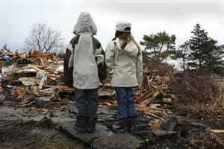
The Sacred Emotions
Gratitude can also come from non-human actions or events
e.g., surviving a natural disaster

Slide 23
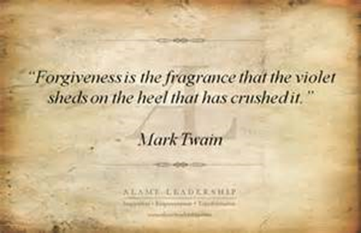

Slide 24
The Sacred Emotions
Forgiveness
Many definitions: consensus is that forgiveness is beneficial
Without forgiveness, anger and resentment take over and can be a cycle of hostility and desire for revenge
Research scenarios: Women more likely to forgive than men, children less willing to forgive than adult, older adults more likely “let bygones be bygones”

Slide 25

The Sacred Emotions
Forgiveness
Aspects of Forgiveness
Cognitive (changing negative judgments)
Emotional (overcoming resentment)
Behavioral (ending indifference)
Forgiveness means overcoming the hurt, resentment, and aggression that accompany being the target of abuse

Slide 26

The Sacred Emotions
Forgiveness
Forgiveness is NOT:
Simply tolerating or forgetting an injustice
Using denial or suppression
Forgetting, denying, or minimizing the hurt
Condoning what was done
Allows us to move on from transgressions
Forgiveness promotes well-being
Should enhance shared humanity and may deepen a connection with others and increase one’s compassion

Slide 27

The Sacred Emotions
Forgiveness: Phases of Forgiveness
Uncovering phase
Decision phase
Work phase
Deepening phase
Notes:
Uncovering phase: Explore how resentment and anger are destructive.
Decision phase: Making choice to forgive.
Work phase: Tries to find understanding of why offender did so.
Deepening phase: Gain deeper sense of meaning as result of injury.

Slide 28
The Sacred Emotions
Forgiveness: Phases of Forgiveness
Uncovering phase
How resentment, anger, hurt is exerting destructive impact on life
Decision phase
Making a choice to try to forgive
Work phase
Reframe incident, accept hurt, try to find empathic understanding for why offender did what they did
Deepening phase
Try to gain deeper sense of meaning
Notes:
Uncovering phase: Explore how resentment and anger are destructive.
Decision phase: Making choice to forgive.
Work phase: Tries to find understanding of why offender did so.
Deepening phase: Gain deeper sense of meaning as result of injury.

Slide 29
Forgiveness
Cognitive-Affective Transformation
(Tangney and Colleagues)
- Freely choosing to “cancel the debt”& give up the need for revenge
- Giving up negative emotions is key
- Removing self from the victim role

Slide 30
The Sacred Emotions
Forgiveness: Self-forgiveness
Role of blame and guilt
“I did a bad thing.”
Involves taking responsibility for bad act or actions, then let go and move forward
We must take responsibility for our behavior and also make amends to the other person
Then, let go of self-absorption and self-criticism

Slide 31
The Sacred Emotions
Compassion and Empathy
Ability to connect deeply with others
Compassion, empathy, and altruism often go together
Empathy helps build positive relationships
In Buddhist tradition, two hallmarks of well-being are compassion and wisdom

Slide 32
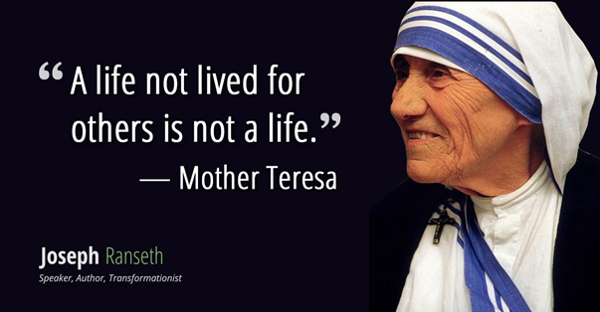

Slide 33
The Sacred Emotions
Self-compassion
Being kind toward oneself is better way to change behavior
Self-compassion makes us happier, optimistic, wiser
Self-compassion adults had greater motivation for self-improvement

Slide 34

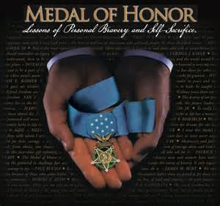
Altruism
Behavior aimed at benefitting another person
Volunteerism - a related concept

Slide 35
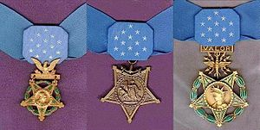
Congressional Medal of Honor
USA highest military honor
Awarded for personal acts of valor that go above and beyond the call of duty
Awarded by the President
3 versions: 1 for Navy, Marine Corps,
and Coast Guard, 1 for Army, 1 for Air Force
Created in 1861 during Civil War
3508 recipients of the Medal of Honor. • Today there are 71 Living Recipients of the Medal of Honor.
March 25th National Medal of Honor Day
http://www.cmohs.org/

Slide 36
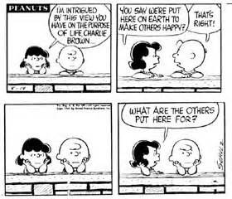
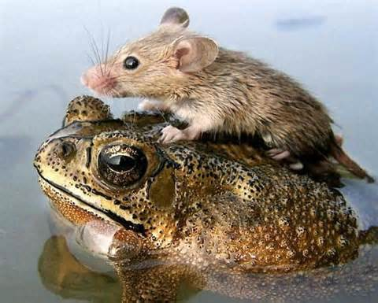
Altruism
Motivated by:
Personal egotism
Empathy…desire to benefit another
Other suggested motivations:
Collectivism: valuing group over self
Principalism: moral integrity

Slide 37
3 Types of Altruism
Reciprocity-based
Usually egotistic because perform a helping behavior in the hope that the other will help you
Care-based
Help because of feelings of empathy for recipient
Kin-based

Slide 38
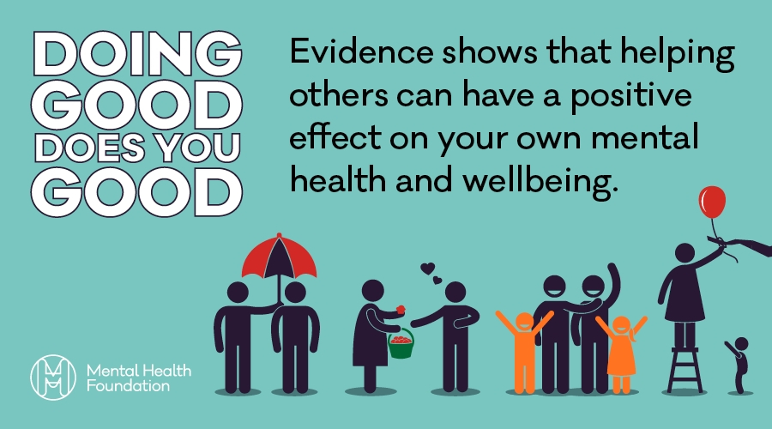

Slide 39
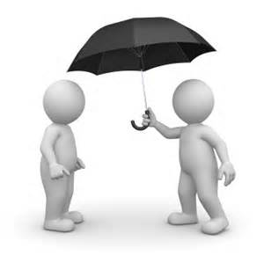
Altruism – The Egotism Motive
The motive to pursue some sort of personal gain or benefit through targeted behavior
One of the most influential of all human motives

Slide 40
Altruism – The Egotism Motive
We care for others because it benefits us
Many argue that all altruism is motivated by egotism
- underlying personal benefit even if not intended

Slide 41
Altruism – The Egotism Motive
General forms of egotism: helping others can lead to:
1. Public praise or material reward
2. Avoid social or personal punishments for failing to help
3. Lessen personal distress at seeing another’s trauma

Slide 42
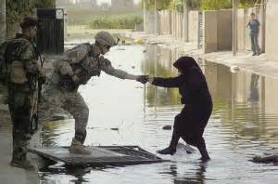
Altruism – The Empathy Motive
Empathy is an emotional response to the perceived plight of another person
Feel what the other person is feeling
May entail a sense of tenderheartedness

Slide 43

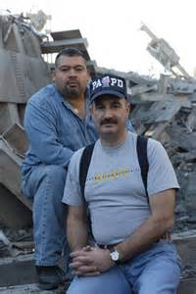

Altruism
Jason Thomas
Was in Long Island
Had been out of Marines
Put on fatigues and drove to NYC
Dave Karnes
Accountant; was in Wilton CT; left work
23yr Marine veteran
Drove to church and asked them to pray that God would lead him to survivors
Reinlisted
Will Jimeno and John Mcloughlin
A Tribute to Heroes

Slide 44
The Sacred Emotions
Humility
Being humble allows us to
Acknowledge mistakes
Openness to others’ opinions and ideas
Appreciate ways people contribute to the world
Humility helps us to live life of quiet joy, satisfaction, wisdom, and contentment

Slide 45
Religious Experiences
Religious experiences may be intensely positive
Positive emotions tend to accompany religious experiences
Transcendent experiences make people feel they have entered higher state of consciousness

Slide 46
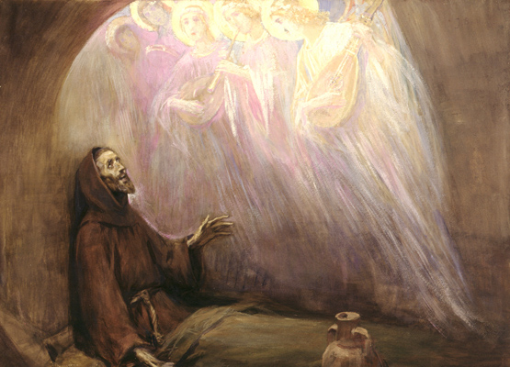
Religious Experiences
Elation and Awe
Elation: experiences of momentary joy; our response to an act of moral beauty, such as witnessing an act of compassion
St. Francis of Assisi
Viewing these acts can produce positive emotions
For some people, these moments reorient their lives

Slide 47
St. Francis of Assisi
In the year 1206, Giovanni Bernadone, the 23-year-old son of a wealthy merchant, went on a pilgrimage to St. Peter’s Basilica in Rome. He could not help noticing the contrast between the opulence and lavishness within—the brilliant mosaics, the spiral columns—and the poverty of the beggars sitting outside. He persuaded one of them to exchange clothes with him and spent the rest of the day in rags begging for alms. It was one of the first great empathy experiments in human history.
This episode was a turning point in the young man’s life. He soon founded a religious order whose brothers worked for the poor and the lepers, and who gave up their worldly goods to live in poverty like those they served.
https://www.yesmagazine.org/health-happiness/2014/11/07/empathy-heroes-st-francis-john-howard-griffin-patricia-moore/

Slide 48
Religious Experiences
Elation and Awe
Awe: deep appreciative wonder
Conditions that favor awe
Time for reflection
Capacity to slow down
Capacity to savor the moment
Focus on what one loves
Capacity to see big picture
Ability to trust in the unknowable

Slide 49

Religious Experiences
Wonder
Closely related to awe, linked with qualities of imagination, surprise, and aesthetics
Opening of heart to joy, gratitude, and love
Regarded as a key to heights of human personality

Slide 50


Religious Experiences
Wonder
Experiences categorized into three distinct groupings
Physical (objects, processes within nature; Grand Canyon, sunset)
Personal (interactions with people or their work; infant)
Metaphysical (intense musing on meaning; think about earth’s creation)
Notes:
Physical: Involving objects, phenomena, or processes found in nature.
Personal: Involving interactions with people or their work.
Metaphysical: Involving intense musing on meaning of original stimulus.

Slide 51
Religious Experiences
Peak-Experiences (Maslow)
Brief moments of intense experience
Involve intense joy, wonder, appreciation
Experience connection to larger spiritual reality
Elements of peak-experiences could become almost permanent aspects of daily experience
Resacralization--restoring sense of sacred to ordinary world

Slide 52
Religious Experiences
Conversion
Occasionally, religious experiences lead to transformation (St. Francis of Assisi)
Reorients person’s life in different direction
Highly personal and almost impossible to induce

Slide 53
Contemplative Spirituality
Transpersonal Psychology
Spiritual experiences deserve serious scientific attention
Transpersonal psychotherapy aims at daily experience of liberation or enlightenment
Accepts first-person narrative accounts of spiritual experiences

Slide 54
Contemplative Spirituality
Mysticism
These experiences show reality different from everyday experience
Experience is typically ineffable
Involves sense that profound knowledge has been revealed
Experienced beyond understanding of time and space

Slide 55
Contemplative Religious Traditions
Monastic Christianity
Most easily recognized in Catholic monastic practices
Centering prayer is alternative to MBCT

Slide 56
Contemplative Religious Traditions
Kabbalah
Mystical tradition of Judaism
Has insights concerning human personality and personal growth
Connected the Kabbalah to meditation and transcendent experience

Slide 57
Contemplative Religious Traditions
Buddhism
Considers change as irrefutable truth of human existence
Despite this, we crave stability and complete end to worry
This is the cause of unhappiness, Buddhism asserts

Slide 58
Contemplative Religious Traditions
Buddhism: Nirvana and Enlightenment
Happiness can be found in meditative practice
Nirvana translates to “extinction of thirst”
To realize Nirvana is to be released from all needs and desires

Slide 59
Contemplative Religious Traditions
Meditation in Spiritual Traditions
Two basic styles
Vipassana or insight meditation
Concentration meditation

Slide 60
Mysticism and the Brain
Neurotheology
Brain activity in Tibetan Buddhist monks was recorded during meditation
Found recognizable patterns of brain activity
Among people tested, a Tibetan monk had the most intense shift toward the brain pattern
Notes:
Found recognizable patterns of brain activity: Positive and negative moods.

Slide 61
Mysticism and the Brain
An Unusual Route to Transcendent Experiences
Jill Bolte Taylor suffered a stroke that affected left hemisphere of her brain
Left hemisphere functions of rationality, analysis, and language were silenced
“I felt a sense of euphoria as I lost the boundaries of my body,” she said

Slide 62
Mysticism and the Brain
Entheogens and Religious Experiences
Substances used to foster religious experiences are called entheogens
Certain drugs induced these experiences
Mind-altering drugs offer intriguing research opportunity

Slide 63
Psychological Theories of Religious Maturity
Intrinsic and Extrinsic Religiousness
Extrinsic religiosity
Intrinsic religiosity
Notes:
Extrinsic religiosity: People use their religion as path to egotistical ends.
Intrinsic religiosity: Practices are founded on personal and authentic motivations.

Slide 64
Psychological Theories of Religious Maturity
Stages of Religious Cognition
Fowler’s six stages move from simple to complex notions of faith
Stage transitions allow believers to see contradictions of their faith
The last stage is universalizing faith

Slide 65
Psychological Theories of Religious Maturity
Psychodynamic Perspectives on Religion
Explain processes of creating mature spirituality
Healthy and unhealthy religiousness can be distinguished by one’s relationship to unconscious

Slide 66
Psychological Theories of Religious Maturity
Psychodynamic Perspectives on Religion: Carl Jung on Religion and Spirituality
Spirituality is rooted in need to connect with something larger
We must increase awareness of specific archetypes in collective unconscious
Meaningful way to express understanding is through images, symbols, or rituals

Slide 67
Psychological Theories of Religious Maturity
Perspectives on Morality and Ethics
Moral behavior depended on strong ego to control innate forces
Physiological and cognitive factors combine to influence moral behavior
People had better morality when around clean environments

